Slide 1
American History
Talk 4: British America (1700-1756)

Slide 2
Talks so far
Done
1. Pre Columbia America 20,000 BC -1500
2. The first explorations and settlements 1500-1600
3. The English colonies 1600-1700
Upcoming
4. British America 1700-1753
5. From Unity to Separation 1753-1775 …September 18th
6. Revolutionary War 1776-1783….October 2nd
7. The creation of the United States 1783-1789….October 16th
This completes ‘Module 1’next Module…
‘A Continental Empire’ created (1789-1850)

Slide 3
British America Overview
1
British America and its neighbours
Population growth & new immigrants
The Georgia Experiment
How the colonies were governed
Cultural Changes: Enlightenment and First Great Awakening
Tour of the colonies

Slide 4
North America 1700
2
Indian territory
& unexplored
15,000 settlers
1,000,000 indigenous
250,000 settlers
75,000 indigenous
600,000 setters, 3,000,000 indigenous
Spain on track to dominance

Slide 5
Meet the neighbours
3

Slide 6
French North America
4
Few settlers…despite Sun King (Louis 14th efforts:
Royal directive, not private companies:
Filles de Roi 1690’s
60,000 settlers by 1750 vs 1,600,000 in British America
Notes:
France
Slow to start due to internal wars, fishing & furs….severe climate, Indian wars
Thinly populated… 20,000 settlers vast area, complex alliances, and forts to bloc British…
Dutch

Slide 7
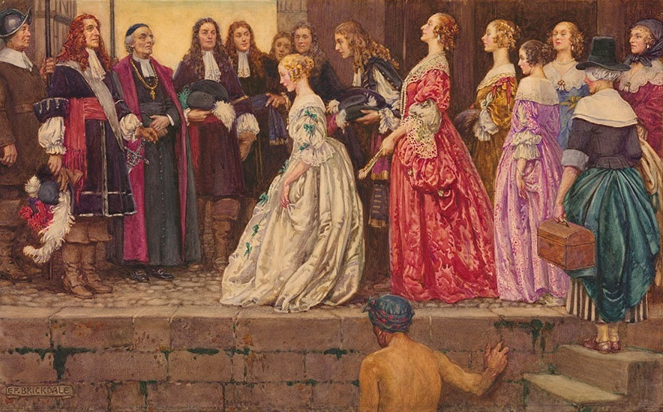
Filles de Roi 1663: Louis XIV recruits 800 ladies for New France
5

Slide 8
French colonies
6
To the north
Furs fish, and lumber, concentrated in ‘Arcadia’ and Quebec, interior… forts only
100 years war with Iroquois but peace with other tribes secured to fight British
Population centred in ‘Arcadia’ and Quebec rest interior forts and traders
To the south
Louisiana and New Orleans: funded by “Mississippi bubble’,
Supposed to be a model city planned but goes bankrupt.
Becomes haven for escaped slaves, pirates, deserters,
New Orleans becomes “ a place of a hundred wretched hovels in a malarias wet thicket of willows and dwarf palmettos , infested by serpents and alligators.”. French priest 1720

Slide 9
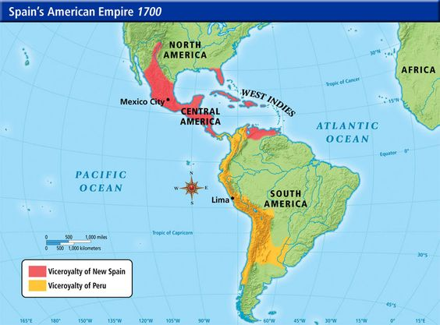
Spain and the America 1700-1763
7
Focus Central and South America,
Indians protected by church, plantation and mining drives demand for African slavery
Immigrants from all classes encouraged by Bourbons some escaping Inquisition
Mexico city population at 100,000, triple size of New York and Philadelphia in 1700
Florida,
Settlers limited to a few forts and missions
Haven for escaped slaves from Carolinas and pirates
Inquisition arrives and targets ‘Conversos’, Indians exempt

Slide 10
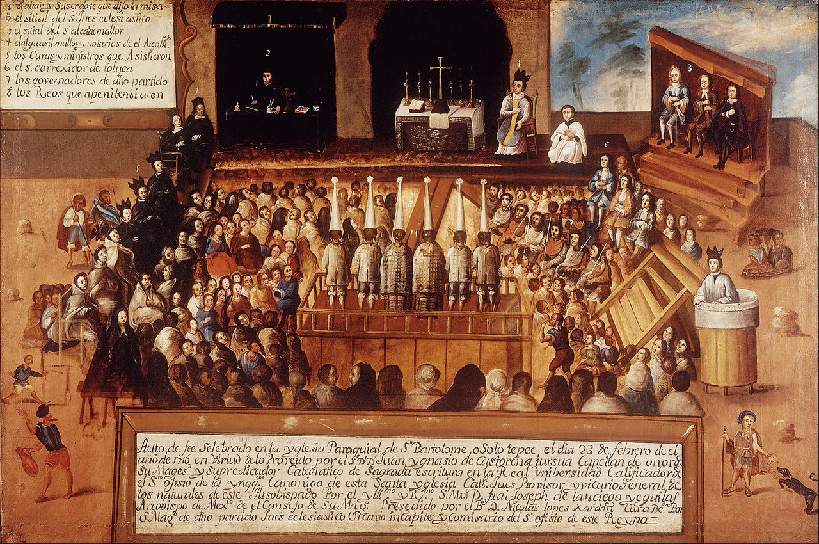
Auto de fe Mexico City 1700’s
8
Rare public event….only 3% of those accused of heresy executed,
50 executions Mexico and 5,000 in Spain ...over 200 years

Slide 11
Spanish and South West North America
9
2,600 settler in Santa Fe
Indians enslaved and sent
To mines
Spanish demand Pueblos
convert
Popee leads revolt 1680,
Spanish Forced to evacuate
500 killed…Popee dies
Spanish reconquer New
Mexico 1692 but abandon
Conversion attempts, grant
Lands to Pueblo chiefs and
Accommodate local customs

Slide 12
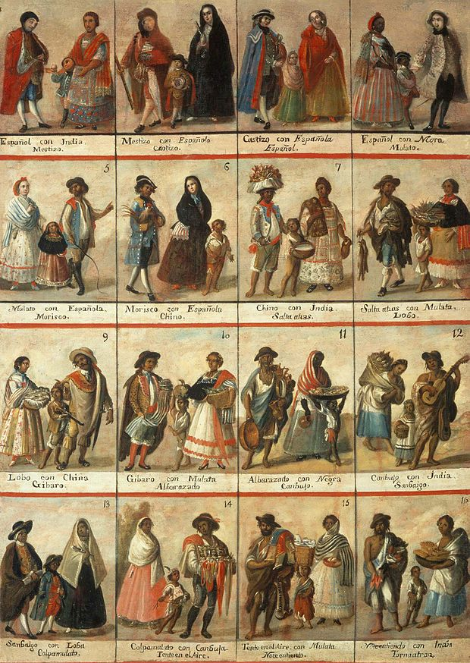
Spanish North America: Casta System
10
Mixed society inter marriage
Accepted as normal
Rights and obligations dependent
on birth condition
The idea: room for everyone, a
different room…but unlike in
much British North America
better than no room

Slide 13
British America
11

Slide 14
Wars with the neighbours 1700-1750
12
King Williams War (1689-1697) vs France and Spain …inconclusive
Queen Anne’s war (1704-1713)..versus Spain British take Newfoundland and Maine (aka Arcadia from France)
Yamasee War in the Carolinas (1715-17) , united Indian tribes of South East kill 70% Carolina settlers, English reinforce colony and drive Indians west
King Georges War (1744-1748) vs France and Spain inconclusive
British invasion of Florida fails,
Spanish invasion of George repelled
British colonial life thrives despite being framed by warfare

Slide 15
British American Population 1700 -1760
13
Population doubles ever 20 years…from 250,000 to 1,600,000 by 1760
Most population growth due
to high birth rate
500,000 + immigrants over 50
years, largest group slaves
from West Africa

Slide 16
1700-1760 Immigrants to British America by type
14
300,000 slaves from Africa, 90% to South & Mid
100,000 English: mix of Indentured Servants, debtors (Georgia), parolees, younger sons and their families lured by opportunities and higher standard of living
60,000 Germans…Pennsylvania
40,000 Scotch Irish…to mid Atlantic, Hill Country
10,000 Scottish, French, Dutch
Slavery considered ‘normal’ in 18th century and needs explanation

Slide 17
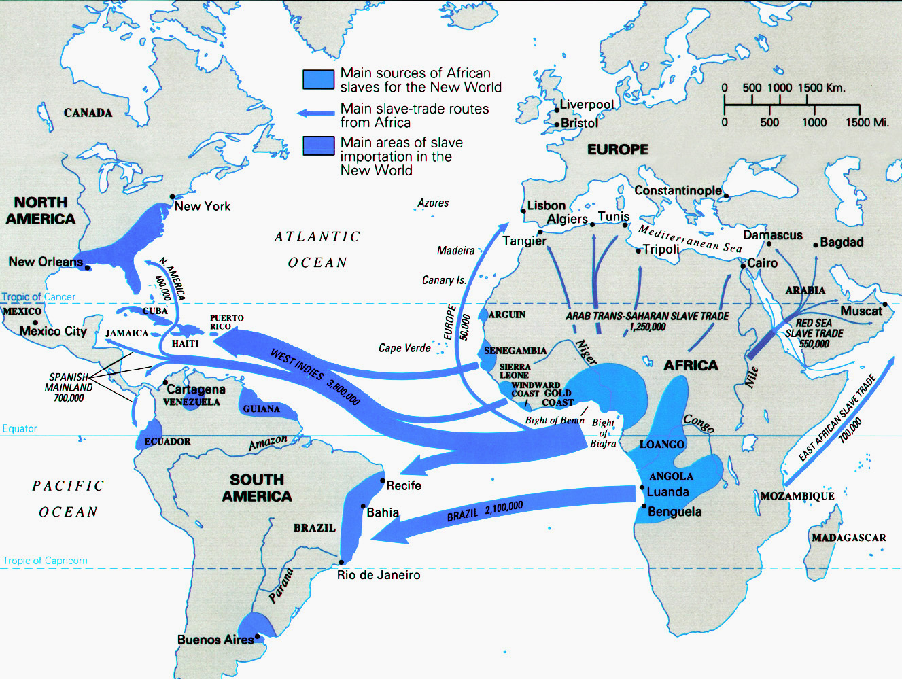
18th century Slave Trades
15
Demand triggers
New World, mining, sugar, tobacco, rice & indigo, and cotton
Middle East: domestics, Plantations, soldiers, Construction, eunuchs, harems
African Kingdoms
Demand for Industrial
Goods and weapons
‘Three ‘trades’ 18th century: White slavery, Islamic, and North Atlantic

Slide 18
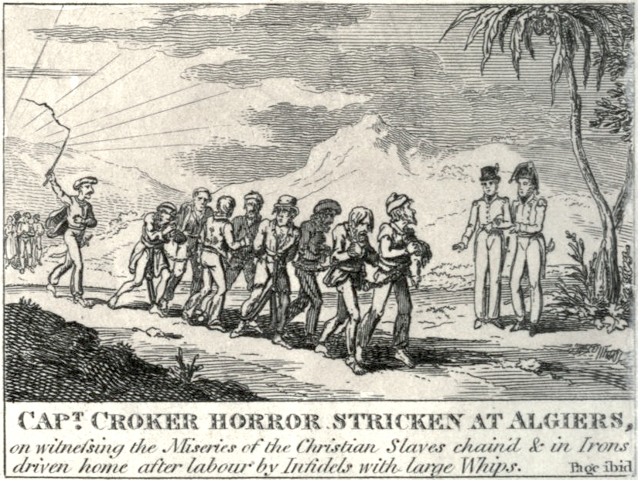
White slave trade….Barbary Pirates
16
Raids to south Europe
Spain, Cornwall
Iceland from 10th to
Early 18th century.
Major Source of income
Berbers
Reduced to 10’s of
Thousands in 18th
Century as
European navies
Grow more powerful
Limited seizures of
Ships, system of pay
Offs and ransoms

Slide 19
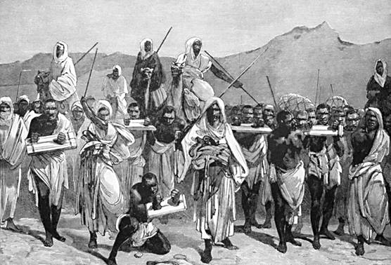
Islamic Slavery
17
Custom and practice
8th to 19th century, 16 million
Slaves transported to Middle
east
30% death rate during
Transportation, 30% death
Rates for males due to
castration
No anti slavery agitation
Or free press, supressed
By British Navy during 19th
century but continues
Today (banned Saudi Arabia
1962…. ?)

Slide 20
Trans Atlantic Slave Industry
18
Demand driven by demand to work mines and plantation in South America (mines) West Indies (sugar) as indigenous people die off and secure protection from Catholic church
12 million transported 1500-1880s
10% die in transit
90% to Brazil and West Indies
African Kingdoms increase supply due to growing demand for Western goods and guns to conquer others ….and better prices from Europeans
North African Trade ’industrialised’
British Africa Company transports 40% in 18th century,
Distribution centres built along African coast by Europeans and Africans
‘Improved’ ship design and transportation

Slide 21
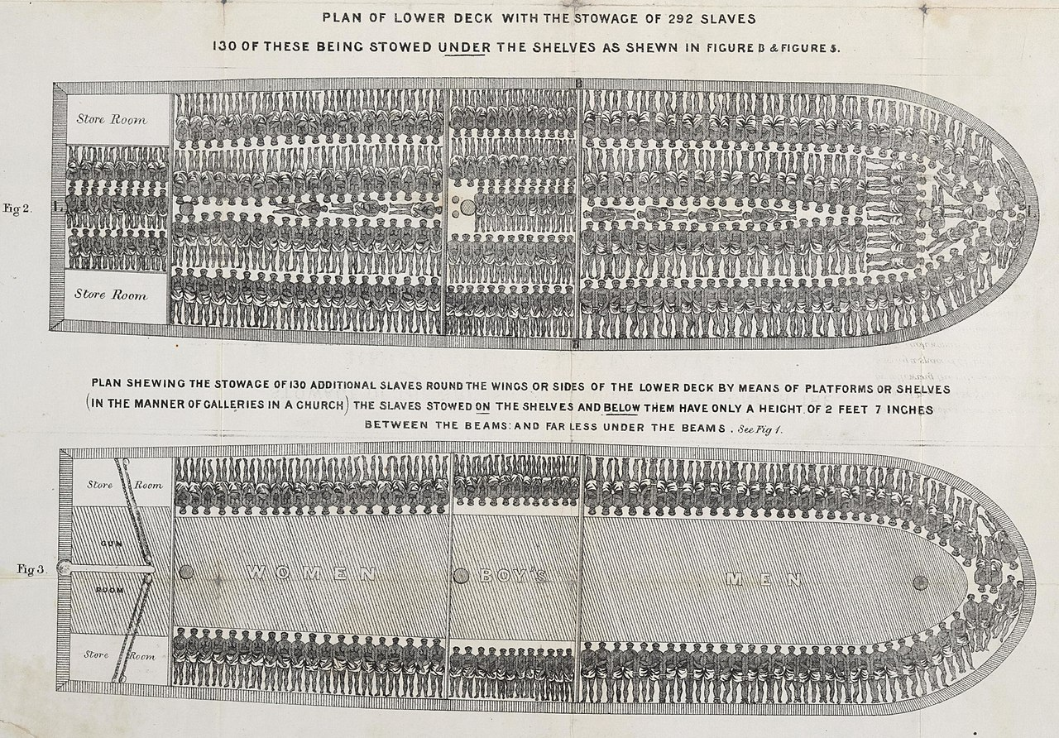
British and Slave Trade ( volume drives profit)
19
Notes:
Slave Trade
14 million Africans to New World 1500 - 1870
95% of slaves to South America and Caribbean
10% died in transit (vs 20% in overland Islamic Slave Trade)
300,000 to North America 1700ss Lower death rates in North America, higher birth rates, more intact families, plantation work less lethal than mines
The most lucrative line of the 18th century (buy save £5 in Africa, sell for £40 Americas, inter regional trade.
British naval power a natural fit and Mercantilist belief in maximising national wealth through trade and exports
Institution unquestioned till last 18th century and then only in Britain…

Slide 22
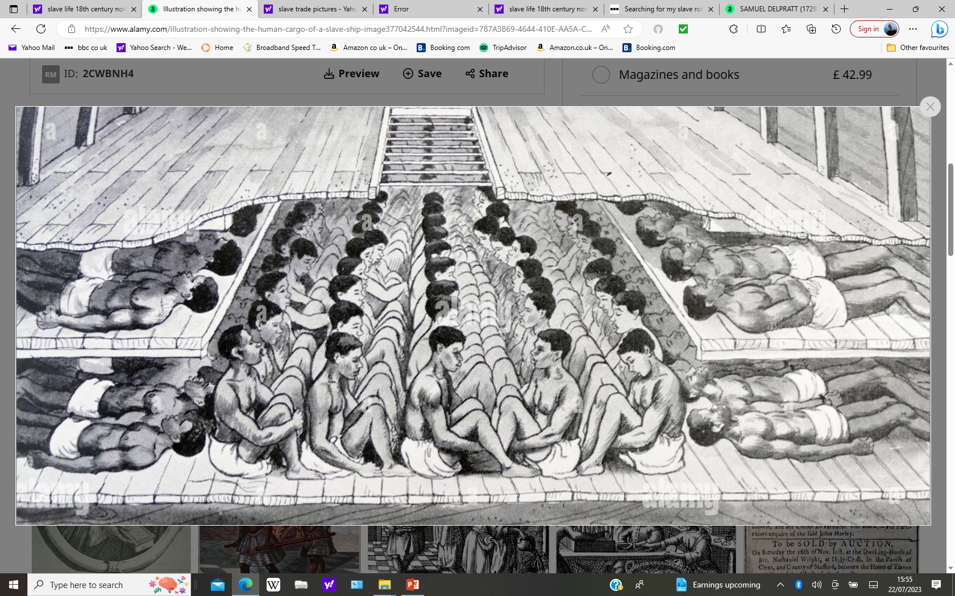
British and Slave Trade: people as cargo
20

Slide 23
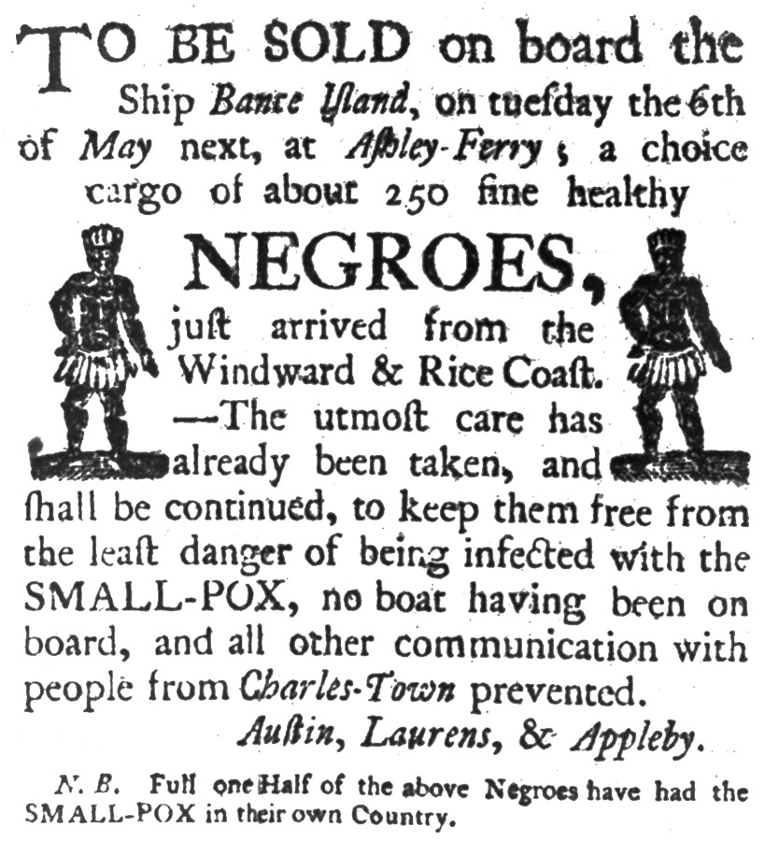
The slavery business
21

Slide 24
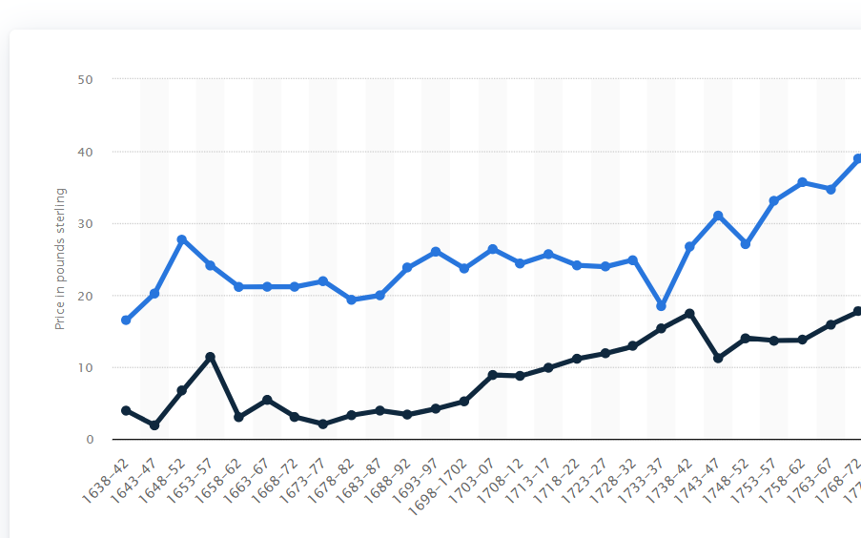
An ugly but profitable business!
22
Average price
In Colony
West African
purchase
price
£1 in 1750 worth £280 in 2023
Cost of 250 slaves @ £10 x283 = £700,000,
Price in Charleston 225 x £30X 283 =£1.910,000 (assumes 10% die en route)
Gross profit = £1.2m less transport and crew cost …offset by sales of guns to Africans and export of tobacco and sugar to Europe

Slide 25
Slave life north America
23
New arrivals separated to prevent communication between tribes
Conditions better than in West Indies and South America
Tobacco, cotton, and rice less deadly than mining and sugar cultivation
Chattel slavery laws introduced late 17th century, buy slave, get family,
Higher costs of slaves vs South increases property value of Master and incentives care
Life styles
Literacy banned, attempts to prevent exposure to Christianity
‘House slaves’ and slaves with metallurgical and farming skills become ‘elite’
Some slaves ‘manumitted’ by owners or able to buy freedom from allowed work.
20% of Southern colonists own slaves…on average 8 for tobacco, wheat, plantations up 20 several hundred …1% Northerners

Slide 26
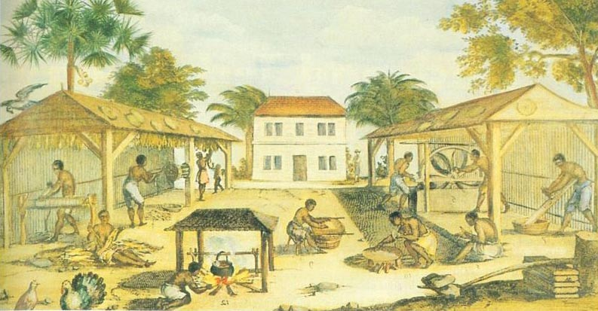
Tobacco Farming Virginia 1750
24

Slide 27
Other Immigrants
25
The ambitious younger sons of middle class English due to favourable publicity and incentives ….’Head right’ system (right to 50 acres if worked for xxx years)
Germans: appeal of Pennsylvania and toleration, wars of Central Europe, and religious persecution of Quakers, Mennonites, Amish,
Scotch Irish’…’Border People’: economic migrants: Protestants and Ulster….restive, anti authoritarian, fiercely independent, accustomed to violence, opposed to Anglicanism,
Scottish Highlanders: deported after supporting Jacobite rebellion followed by ‘clearing of Highlanders’ to make way for sheep

Slide 28
‘Scotch Irish’
26
Protestant settlers in Ulster seeking improved opportunities, freedom from high rents, wars with Catholics, seeking ‘a land of their own’
Fiercely resistant to authority & accustomed to use of violence to resolve disputes…’honour system’…inclined to duels
Virulently anti catholic and ‘others’….such as indigenous peoples.
Majority migrate West where ‘free 'land is available
“we have had 12 or 13 slave of ships from the North of Ireland with a swarm of people.”..
John Dickinson, Philadelphia 1710

Slide 29
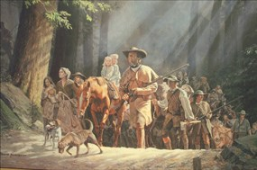
Scotch Irish (1)
27

Slide 30
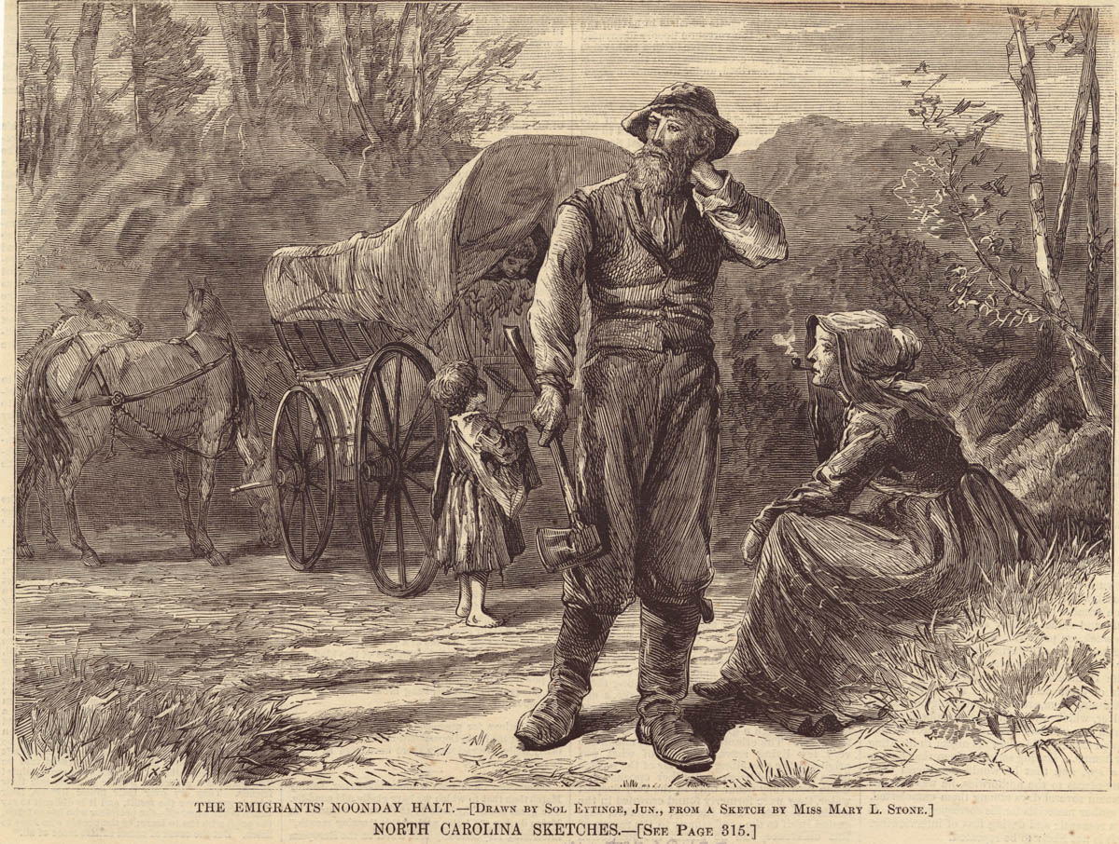
Scotch Irish (2)
28
They were pioneers, frontiersmen, these Scotch-Irish: their general equipment consisted of a rifle, the Bible, and the Psalms of David."
“They were pioneers, frontiersmen, these Scotch-Irish: their general equipment consisted of a rifle, the Bible, and the Psalms of David." ….(Robert Garland. Early 20th century historian and Pennsylvania councilman

Slide 31
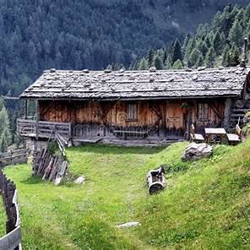
Old west pioneer homes
29

Slide 32
Intermission
30

Slide 33
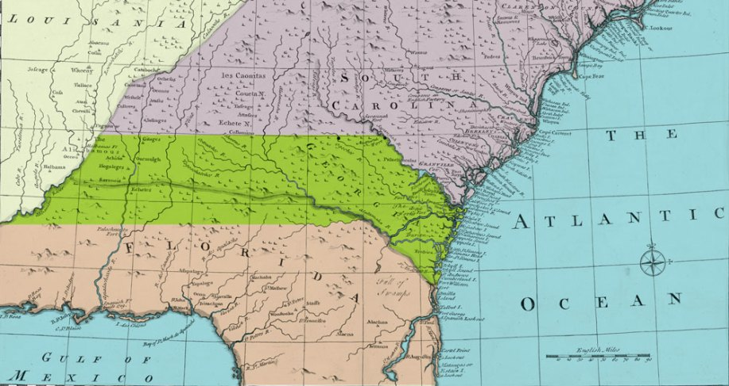
The Georgia Experiment
31
BRITISH
George 2nd wants new
colony to block Spanish
Yakimah Indians
1732, 22 ‘enlightened’ Trustees secure charter to create ‘model ‘colony
SPANISH

Slide 34
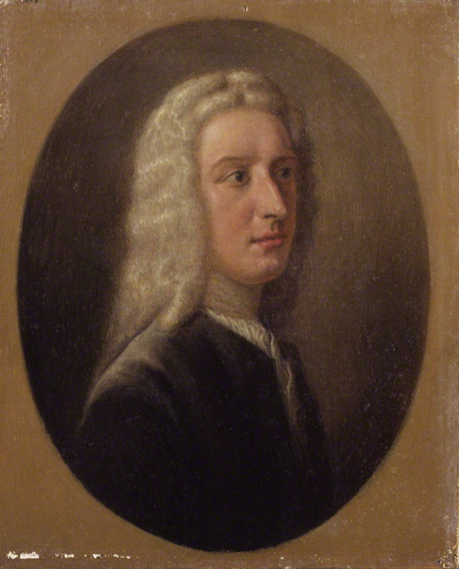
James Oglethorpe (1695 -1780)
32
10th son wealthy landowner, soldier,
‘Enlightened’ thinker …joins Trustees
Georgia to be a model colony
No slavery, no alcohol, planned cities
, equal sized plots of land, all welcome
Jews, Catholics, Indians to be treated
as friends and neighbours

Slide 35
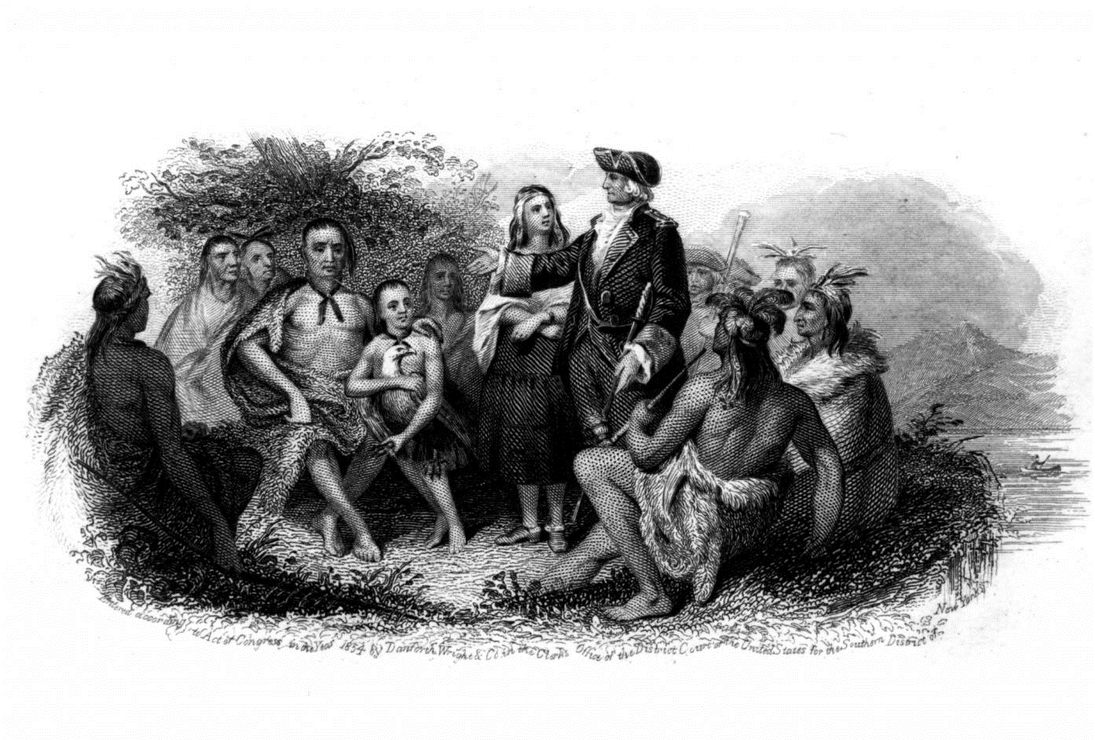
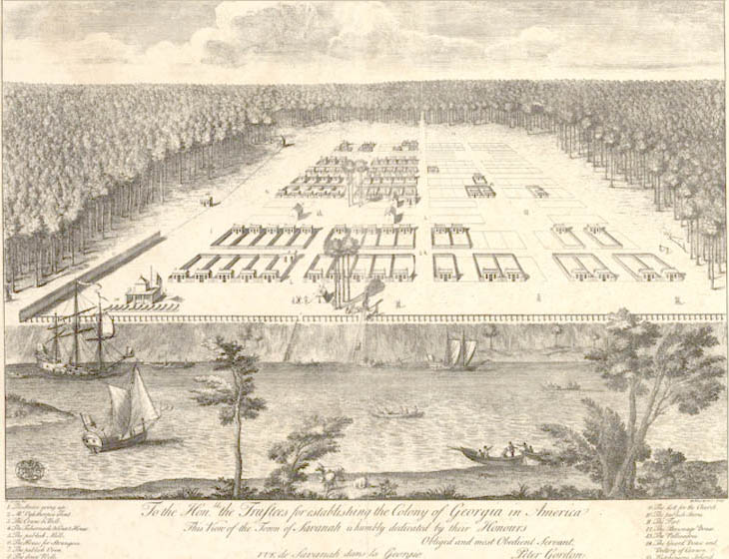
The great (and short lived) experiment
33
Oglethorpe returns to England in 1735 to protect estate
From creditors and introduce Yakimah Indians to Trustees

Slide 36
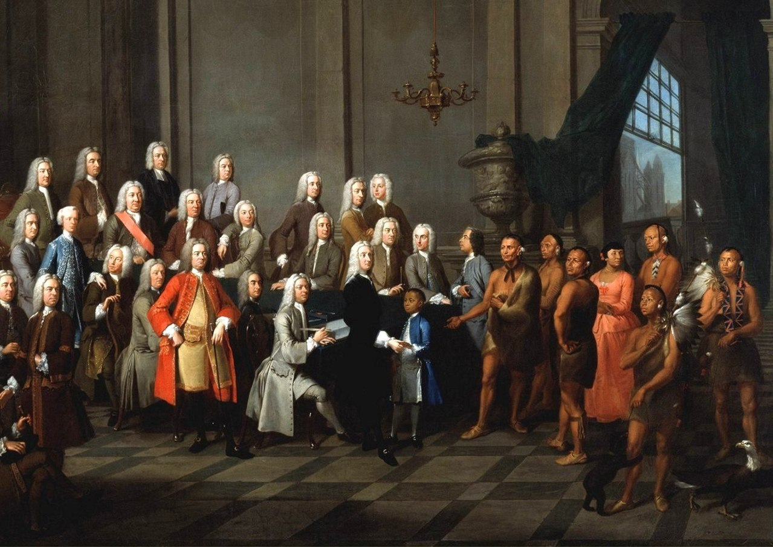
Oglethorpe introduces Chief Tomochichi of Yakimah to trustees in London 1735
34

Slide 37
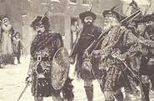
‘Malcontents’ destroy Georgia experiment
35
Self financed Scottish immigrants to Georgia, not beholden to Trustees
Observe life and prosperity in Carolinas, use of slavery, exemption of whites from physical work and want the same
Lobby Trustees to Legalise slavery, sale of alcohol, end land restrictions. Oglethorpe & Trustees give up
Georgia becomes ‘Royal Colony’ 1753
Georgia becomes another ‘Slave State’ …..another ‘might have been

Slide 38
37
Governance and Culture

Slide 39
Mercantilism
38
Economic theory dominant through 19th century….still practiced by China…and nationaliststoday.. Trade = War
Increase supply of gold by maximising exports and minimising imports
The purpose of colonies is to increase the wealth of the motherland, supply raw materials, buy its goods, use its ships
But….
by 1750’s British Americans increasingly see themselves as
‘British’, not colonial peoples

Slide 40
Colonial Governance
39
Three Colonial Types
Charter … Shareholders select Governor and Officials…New England, Virginia and Georgia founded as Charter but become ‘Royal’
Proprietary…Colony ‘property’ of an Aristocrat: Pennsylvania, Maryland, Connecticut
Royal.. King and Parliament select Governor and Council
Most colonies start as ‘Charter or Proprietary but become ‘Royal’ due to politics and insolvency as Britain attempts to impose ‘rational’ government
Three centres of power
Parliament and King control Foreign Policy and trade,
Governors select “Council’ and ‘Placemen’ to key roles in Government and can veto
Assemblies voted by property owners and responsible for local laws and taxes (60% white males vs 15% in England

Slide 41
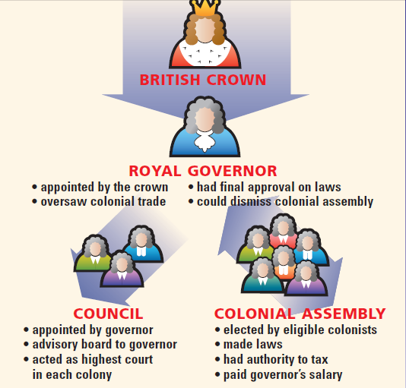
Royal Colony
40
Parliament
Parliament claims to represent British Americans ‘virtually’

Slide 42
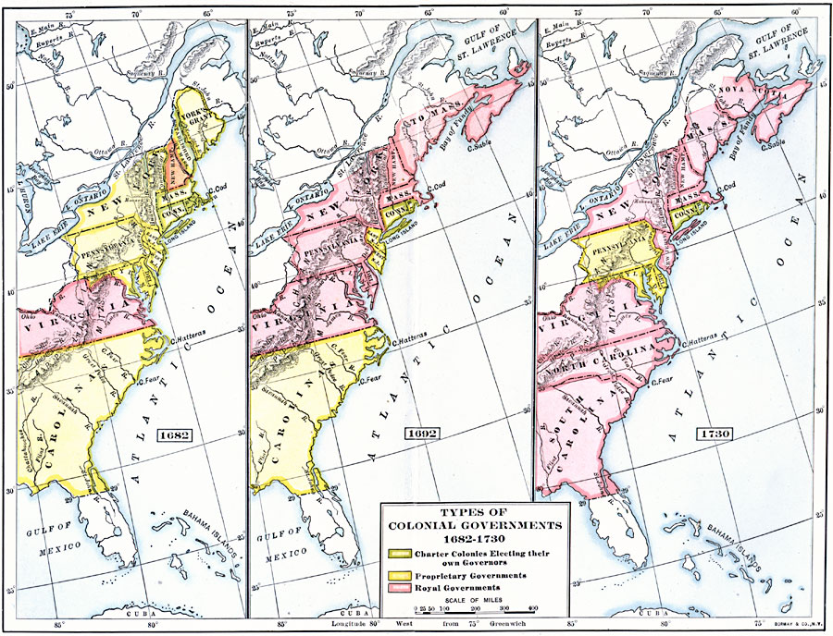
Increase in ‘Royal Colonies’
41
Others go bankrupt or seen as disloyal not sufficiently ‘mercantile’

Slide 43
About the ‘Enlightenment’
42
Intellectual movement from Reformation to French Revolution
Rationalism…logic over belief
Progressivism…humans can make world better, contract government and people.
Empiricism…’good’ must be proven
Cosmopolitan….citizens of world, ‘nation’ a construct
Key thinkers
Francis Bacon (1561-1626) ..empirical thinking
Baruch Spinoza (1632 -1677) …deism, God remote, imperfect, incomplete
John Locke (1632-1704), Jacque Rousseau (1712-1778)..rights of man
Notes:
Enlightenment : European intellectual movement relying on reason and individualism over religion to explain the world
Francis Bacon on method, Spinoza deist thought, Newton physics, Lock government
Needed stable states to gain dominance
Religious wars such as the 30 years war on continent and Civil Wars in England and Ireland replaced by conflicts over state power . Wars continue but not genocidal massacres of 30 years war.
Strong states emerge: Authoritarian regimes of France and Spain, militarily strong but unreformed feudal underlying political economic
Britain and Holland financial power houses, Banks, Stock Ec

Slide 44
Enlightenment and British America
43
British America fertile ground for Enlightenment thinking
High literacy rates in New England states and new cities of New York, Boston, Philadelphia
High participation in civil life, newspapers and coffee shop culture
New universities (Hartford, Princeton Yale, University of Pennsylvania etc)
Central to Free Mason and “Deist” thought 21/56 signers to Declaration of Independence were Masons….pyramid and eye on $1 bill
New generation of ‘British American’ intellectuals emerges during 1750’s
Loyalty to Government dependent `On logic and utility’
…not obedience or tradition

Slide 45
First Great Awakening (1730-1740)
44
Church attendance declining in 18th century British American (and British) society
North American life…prosperous, agricultural and increasingly materialistic as luxuries become available…ongoing fear of Indians
Rise off ‘Deism’,, even Atheism…John Newton… God the great mathematician
Attendance and conformity threatened by profusion of Protestant denominations

Slide 46
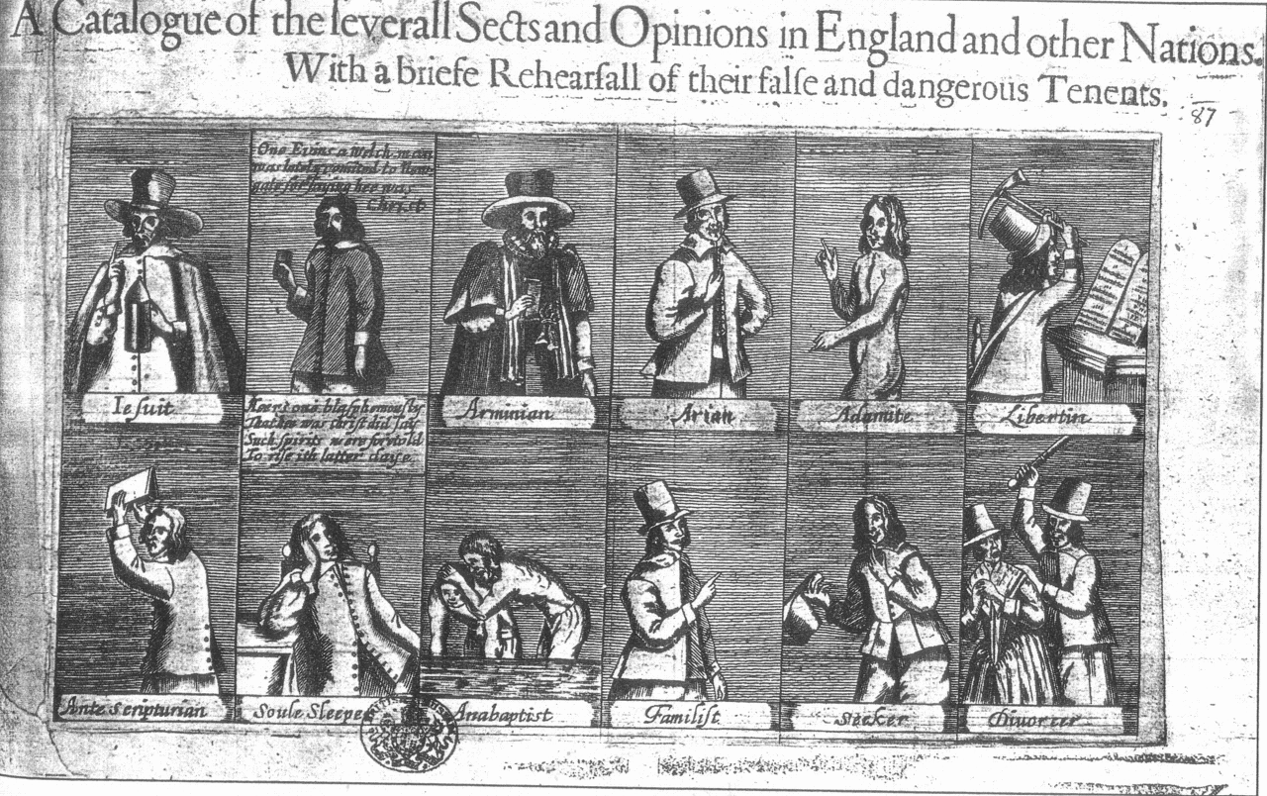
Late 17th century….a profusion of denominations
45

Slide 47
Great Awakening
46
Jonathan Edwards (1703-1758)
Born in Connecticut 5th of 11 children of Presbyterian minister
Child of Enlightenment, attended Yale at age 13, converted to Anglicanism
Rejected ‘Deism’ ..God’s love and power revealed in nature, not disproved
Salvation by Faith alone not by ‘works’ due to man’s ‘sinful disposition’
Slavery justified but manumitted his slaves and opposed slave trade…
George Whitfield (1714-1770)
Son of innkeeper, brilliant student,
Scholarship to Oxford, meets John Wesley, becomes Anglican minister,
To America, sets up orphanages, delivers mass meetings 10,000 to 30,000 all across British America
Preached directly to slaves (yet defended and owned slaves)

Slide 48
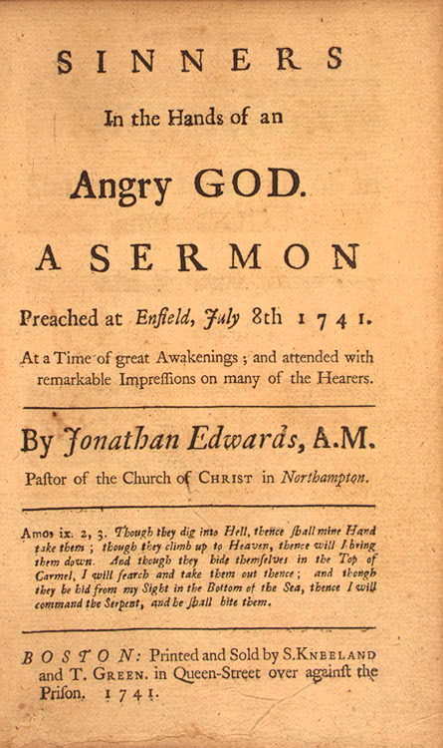
Jonathan Edwards (1703-1758)
47
“The wrath of God burns against them [sinners], their damnation don’t slumber, the pit is prepared, the fire is made ready, the furnace is now hot, ready to receive them, the flames do now rage and glow. The glittering sword is whet, and held over them, and the pit hath opened her mouth under them.”

Slide 49
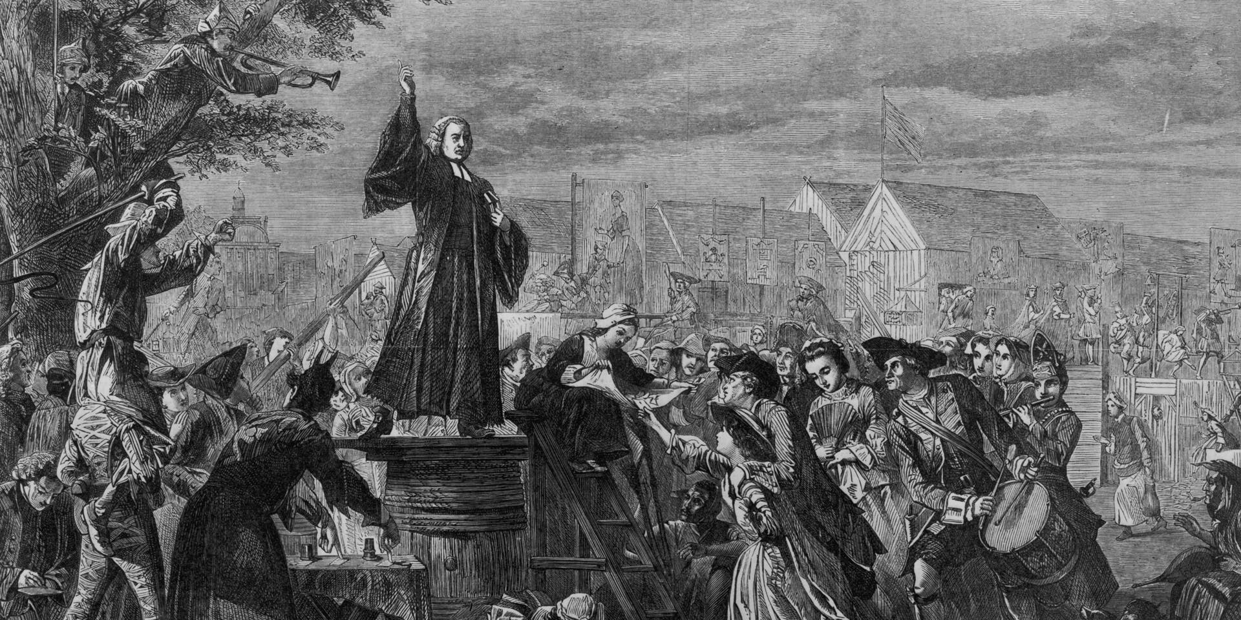
George Whitefield mass meeting
48

Slide 50
Impact Great Awakening
491
First mass movement in the British Colonies
Discredited established Anglican church and government hierarchy…despite its delivery by Anglican ministers..
Builds conflict with “Enlightenment” thinkers
Triggered dialogue on slavery and ‘abolitionism”

Slide 51
Tour of the Colonies
50

Slide 52
Tour of the Colonies 1750
51
 | British % | % voters* | Literacy | Slaves as % Population | Policy vs Indigenous People
New England | 90% + | 80% | High | 2% | Remove/ Eliminate
Mid Atlantic | 70% | 20% | Med | 5% | Assimilate & Cohabit
South | 90% | 10% | Low | 40% | Remove/ Eliminate
Borders/ Interior | 90% | 40% | Low | 10% | Remove/ Eliminate
* Among white males only, estimates based on my reading. Free blacks meeting property requirements legally able to vote in some colonies.

Slide 53
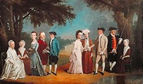
New York ladies 1770
52

Slide 54
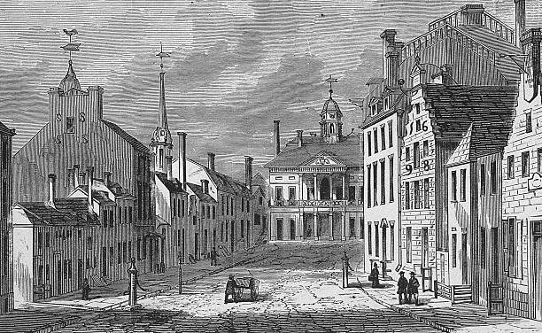
New York….Wall Street 1770.
53

Slide 55
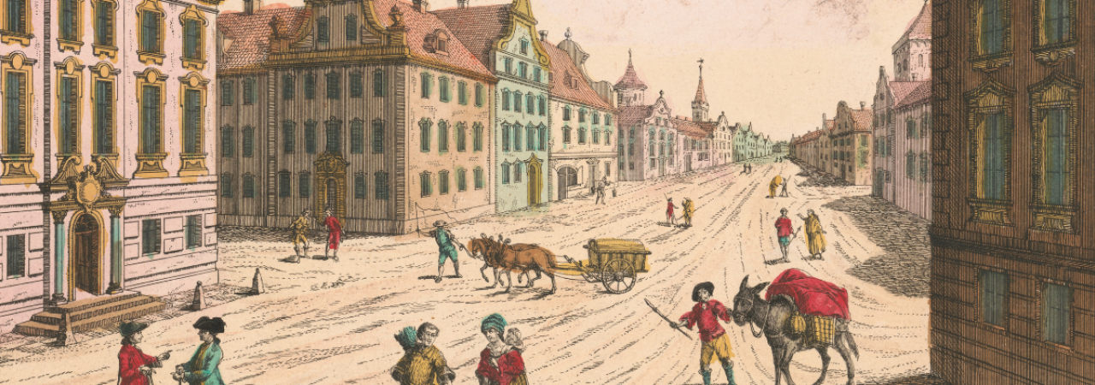
Philadelphia 1750
54

Slide 56
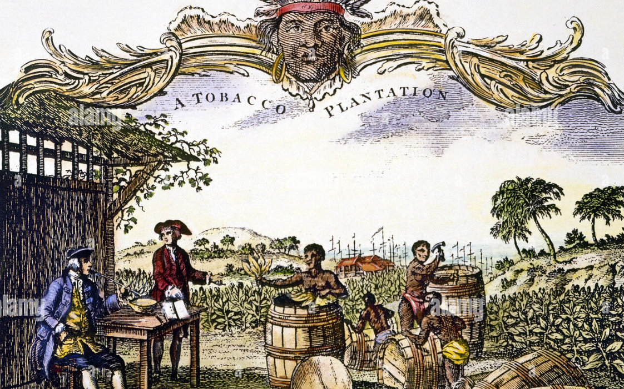
Tobacco Plantation Carolinas 1750
55

Slide 57
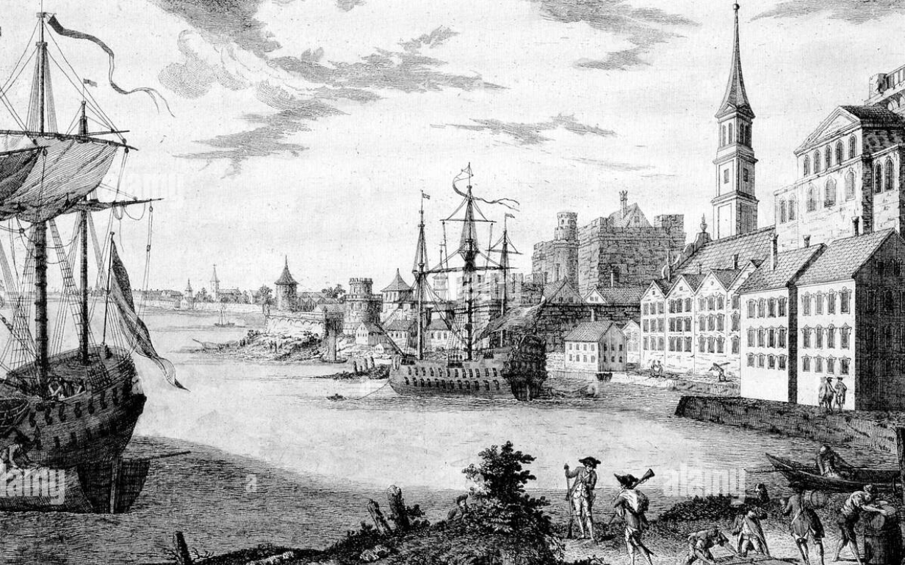
Boston 1750
56

Slide 58
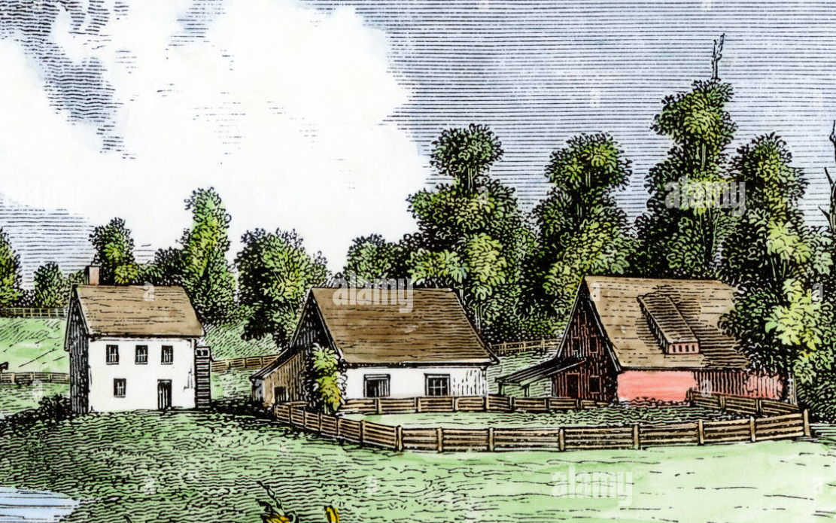
Pennsylvania farm 1760s
57

Slide 59
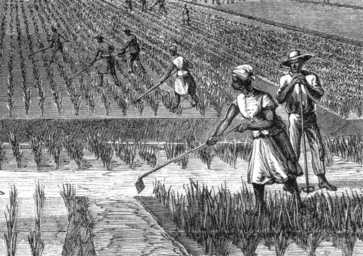
Rice Plantation
58

Slide 60
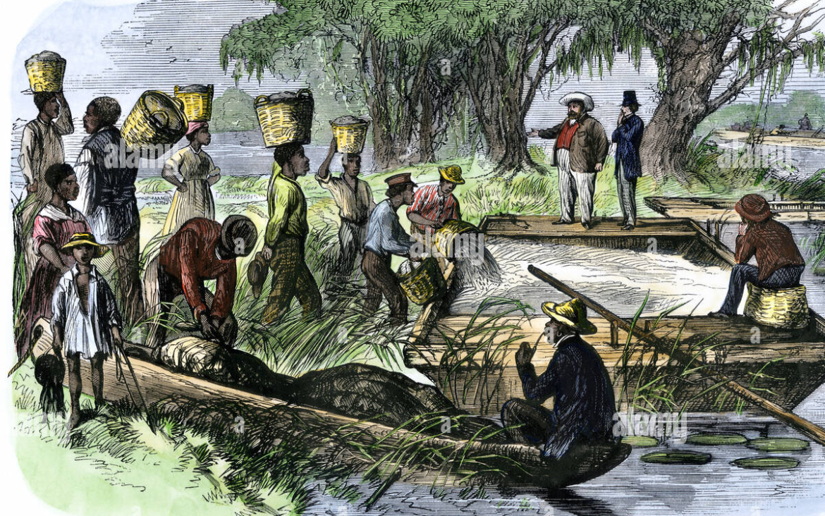
Loading rice harvest
59

Slide 61
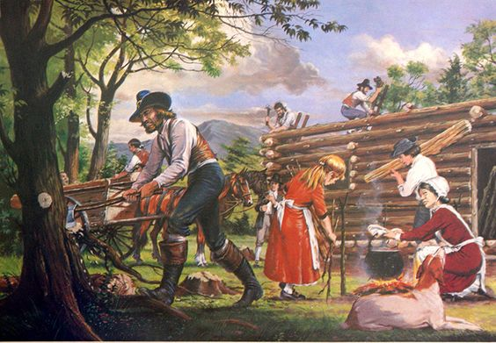
Border Country
60

Slide 62
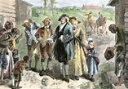
Plantation owner visiting slaves 1760s
61

Slide 63
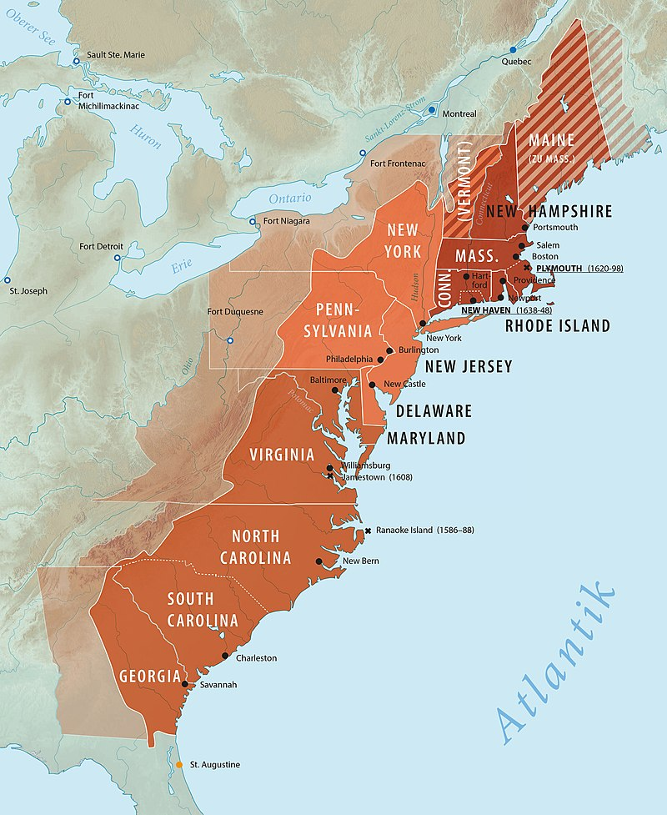
British America 1750
British America 1760
62
East Anglia
Midlands, Holland, Germany Swedes
Scotch Irish, the Borders, Scottish Highlanders
Slaves
West Country

Slide 64
British America 1750
65
A complicated set of 13 colonies prosperous and growing rapidly
An agrarian economy with first cities (New York, Philadelphia, Boston, Savanah) integrated within the British empire
90% of white population still British with shared language and culture
United by fear of Indians, France and Spain
Britain has a prosperous growing and loyal empire and appears
set to rule the Americas…..what could possibly go wrong?

